Slide 1
3D Web Game Odyssey Shooter
Mamud Rostam

Slide 2
Task
To create and present a 3D web game and website using HTML, CSS and JS.

Slide 3
Game Type and Description
Type: Shooting game
Description: The player will have control of a ship that can shoot and incoming projectiles, there will be a timer and score system.

Slide 4
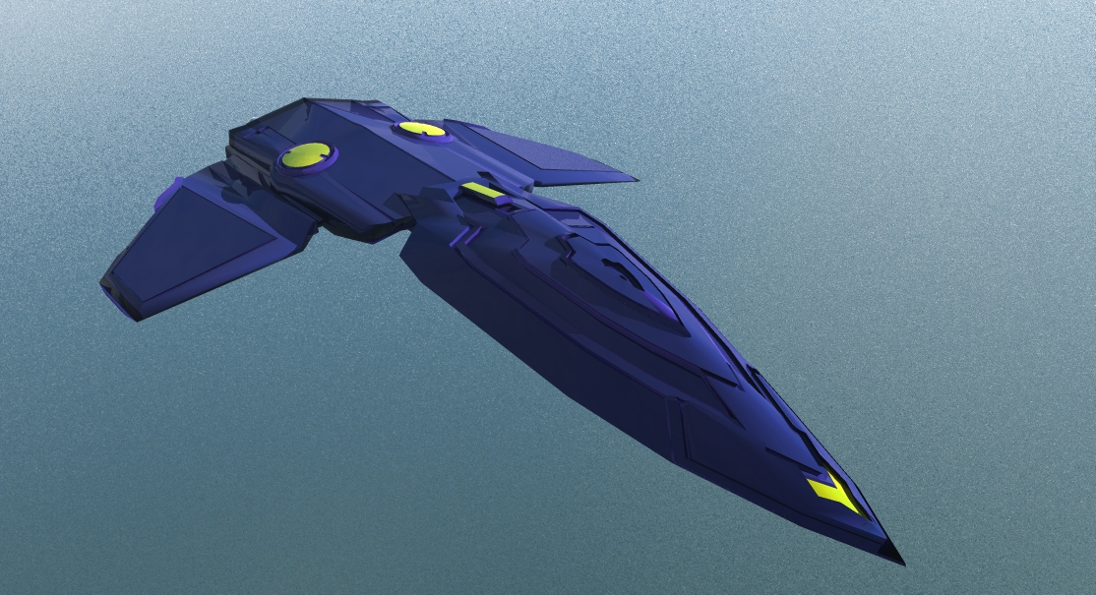

Assets
A.) Player
B.) skybox

Slide 5
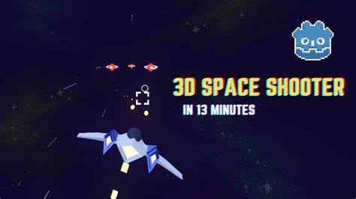
Image examples
A.) Example of what my web game will look like

Slide 6
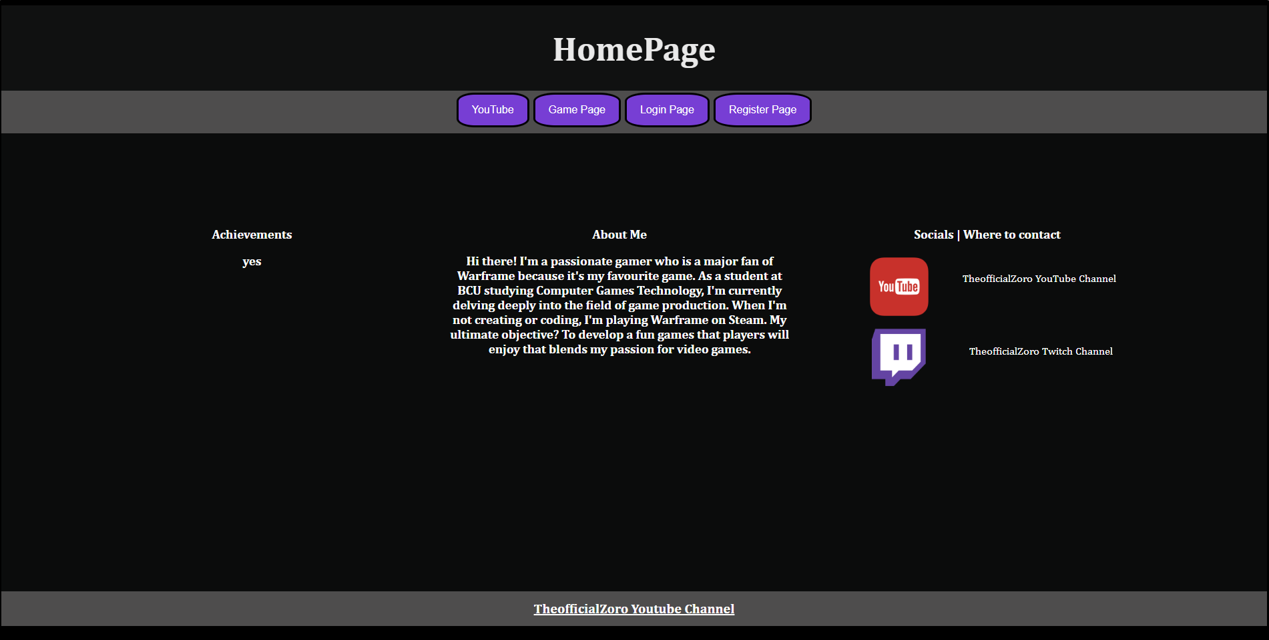
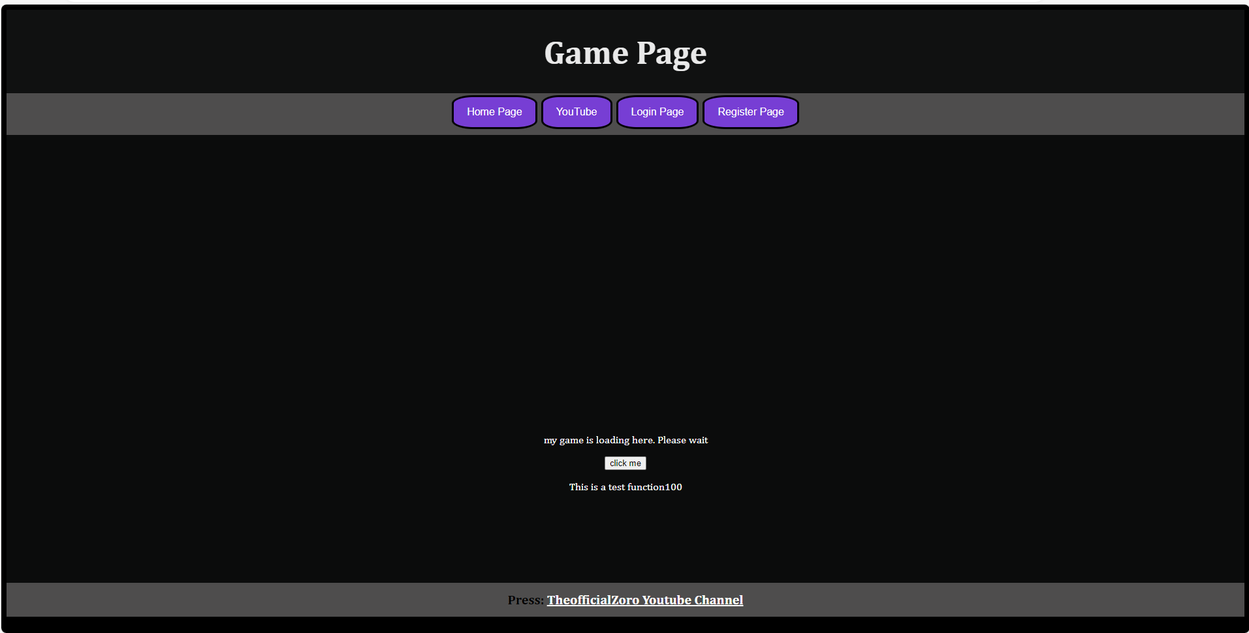
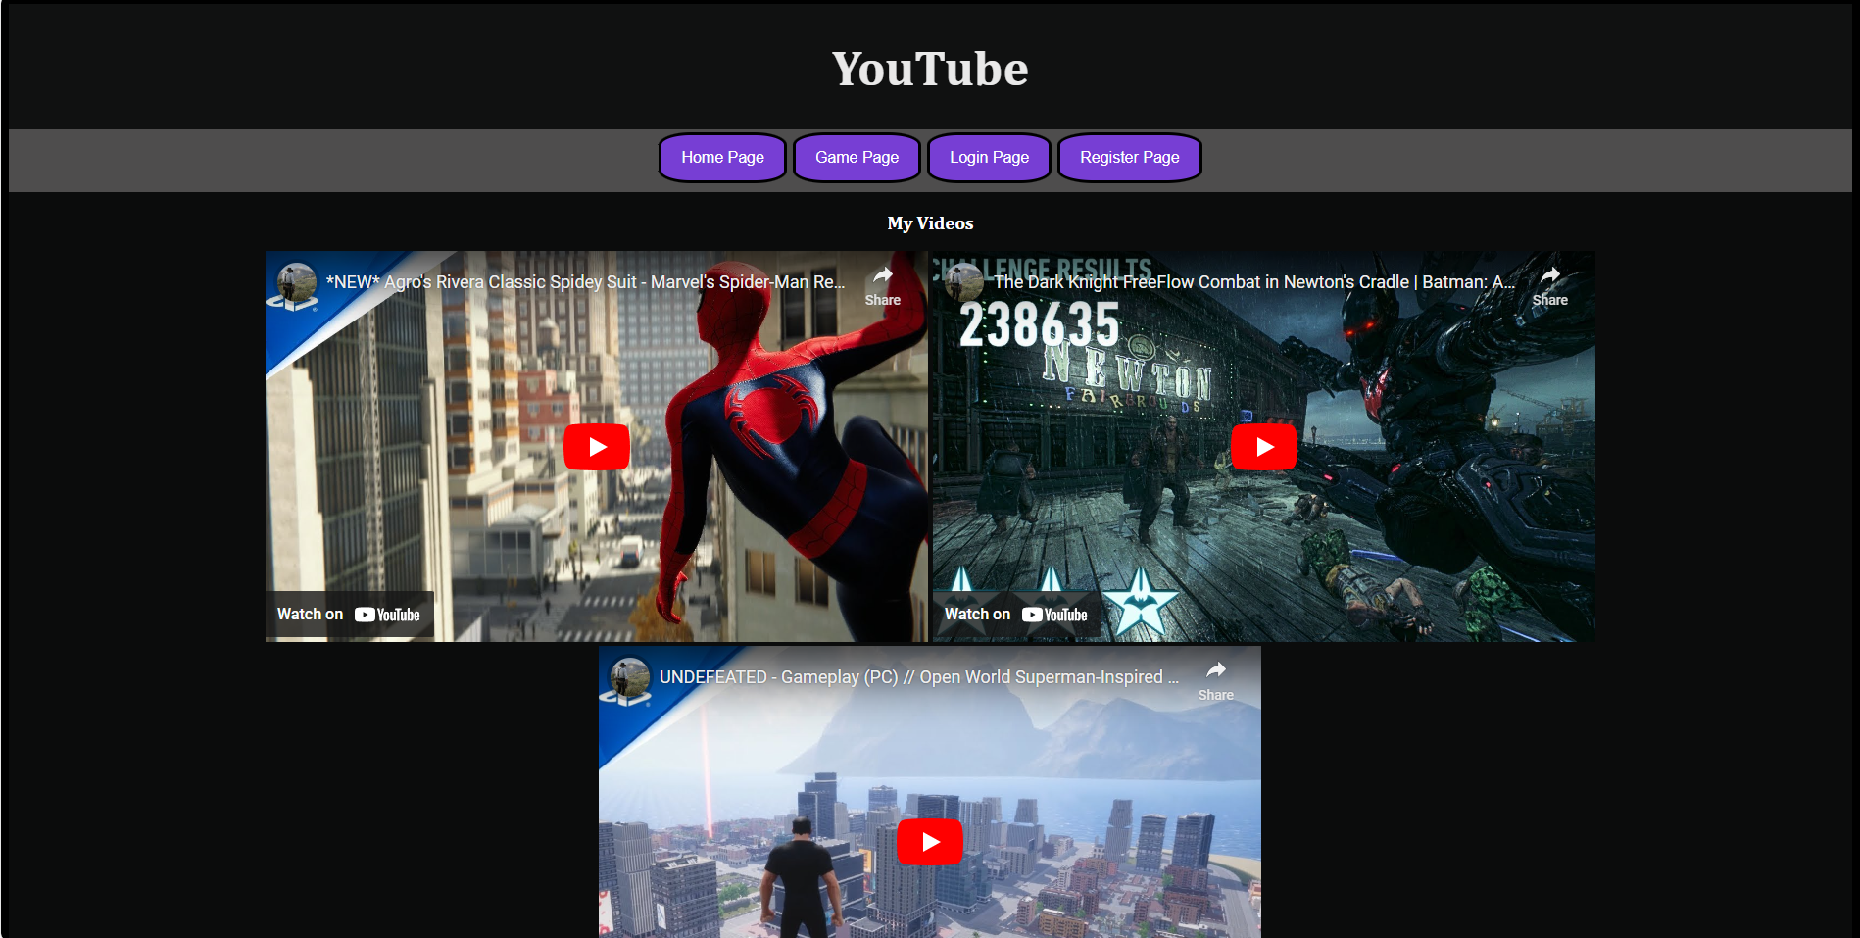
Web preview

Slide 7
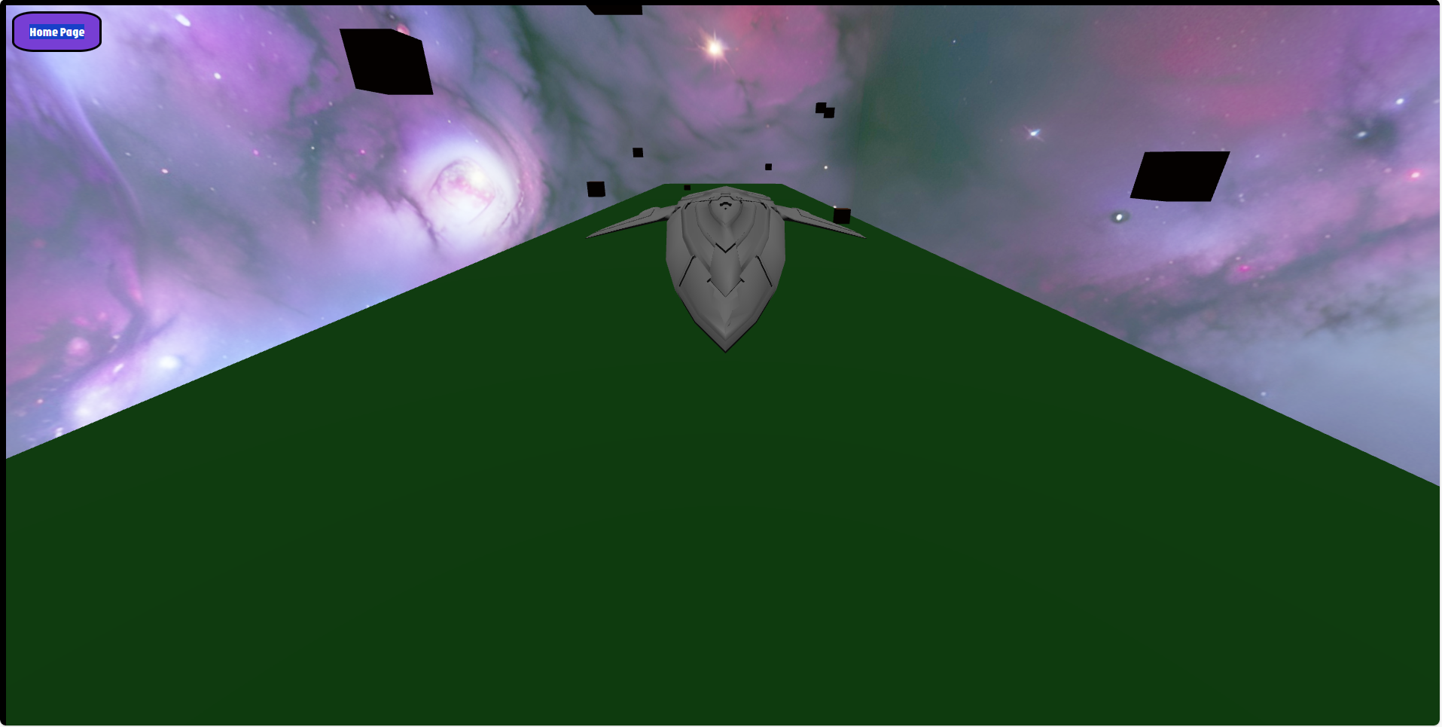
Game preview
A. Image of what my game looks like

Slide 8
Controls
WASD to move around and use the mouse left click to shoot

Slide 9
Refrences
Model – Aircraft Free 3D Models download - Free3D
Background – Newsfeed - Sketchfab
W3schools – W3Schools Online Web Tutorials
Javascript codes - Three.js – JavaScript 3D Library

Slide 10
Any questions

